Slide 1
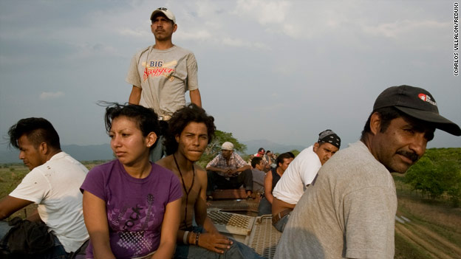
The Representation of the Death Train in “Enrique’s Journey” by Sonia Nazaro and other works
By Angela Sellitti

Slide 2
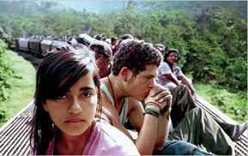
Significance of Study:
This is a topic with many aspects that affects a multitude of people
It is an ethical topic that is reflected in the culture and by the culture
I am a law minor & related laws/ policies are covered in the paper but will not be included in this presentation

Slide 3
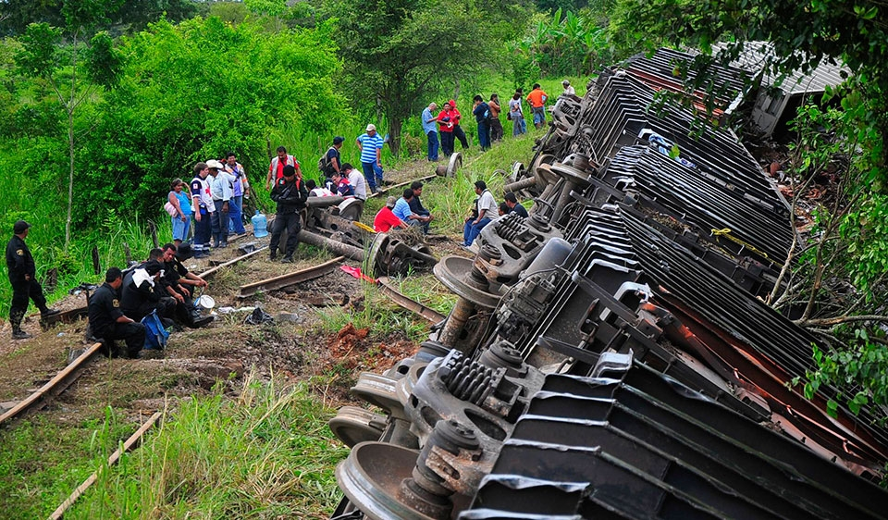
Questions:
How is the death train represented
in literature and poetry?
What are the cultural aspects in this topic?
Why is this an important topic?
What techniques do writers of this topic use & what are styles do they use?

Slide 4
What is The Death Train and
Why Is It Important?
The death train is a nickname given to trains in central america that migrant workers take in the hopes of reaching the U.S.
This dangerous phenomenon affects many people including central americans, people living in towns near the train, Americans, Politicians, human rights activists, families, children, churches, and many other people

Slide 5
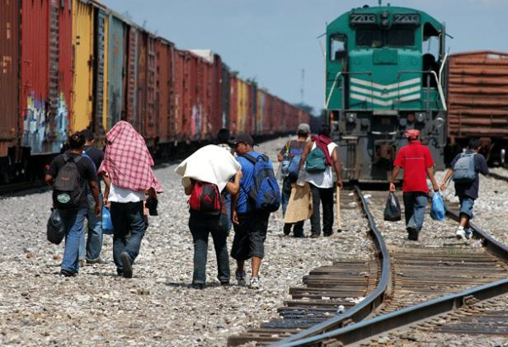
Statistics
Last year Mexico deported 30% more illegal immigrants compared to last year
This number is supposed to double next year
Thousands of migrants die every year on this journey
Hundreds of people try to take the every day
According to Amnesty International,
55,000 people have died since 2007
while taking this journey (most deaths
come from gang violence and police
brutality)

Slide 6
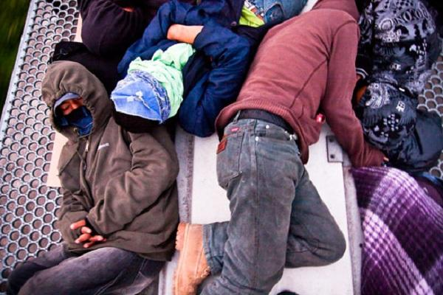
Why is this happening?
Factories are closing and opening in places where labor is cheaper
No job opportunities
To help their family
There are no other options
Financial difficulties
A pollero or coyote is expensive

Slide 7
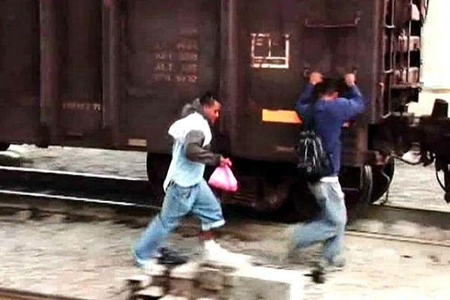
The Risks
The loss of a limb & death
The route is covered with dangerous bandits waiting to rob vulnerable migrants
If they aren’t given money, bandits will kill that migrant
Deportation (in Mexico and U.S.)
The journey is dangerous and difficult, especially during the night and when it is raining
It is common for women suffer from violence and raped

Slide 8
Voces de migrantes viajando en tren a los Estados Unidos
Frank - el salvador 1-15

Slide 9
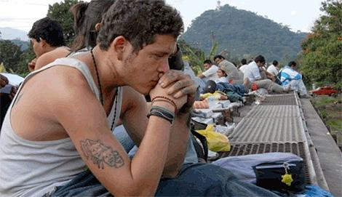
Ethics and politics
Stricter immigration laws
Corrupt authority figures
Hegemony - When socially powerful people use their power to convince less powerful people that it is in their interest to do what is actually in the interest of the powerful people
Neocolonialism- The use of economic, political, cultural, or other factors to control other countries
Hedonism- Acting in one’s own interest to maximize happiness

Slide 10
How is the death train represented in literature and poetry?
It is represented as both a social and moral issue that affects many people
Although the subject itself is sad, many writers choose to represent it as a topic with hope and believe that through more awareness and education, we can begin to work together for a common solution

Slide 11
Enrique’s Journey by Sonia Nazario
Sonia Nazario is an Argentinian writer who choose to write a piece on this topic after talking to her housekeeper who had children in Honduras but came here to work
Nazario did thousands of interviews and spent 6 months taking the train so that she could better understand and write about Enrique’s story

Slide 12
The Beginning
When Enrique is 5 years old his mother leaves Honduras to come work in the U.S.
Enrique goes to live with his family and uses drugs to combat his feelings of abandonment
Eventually he decides to leave his family and pregnant girlfriend to find his mom.

Slide 13
The Dangerous Journey
During his 8 attempts to take the train Enrique is beaten, robbed, is deported (7 times), and almost falls off the train
He encounters many dangerous gang members as well as corrupt police officers
He is shocked by the generosity of the church and by the many people who help him during his passage

Slide 14
The Family Afterwards
After Enrique makes it to his mother, his problems are not over
His resentments take years to heal and their relationship gets worse before it gets better
Maria Isabel, his girlfriend, eventually decides to come to the US and goes without their 6 year old daughter
Together they hope to save enough money to bring their daughter to the U.S.

Slide 15
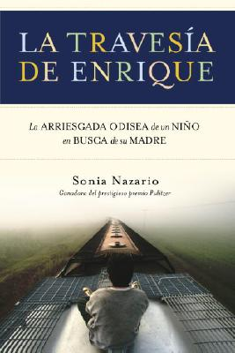
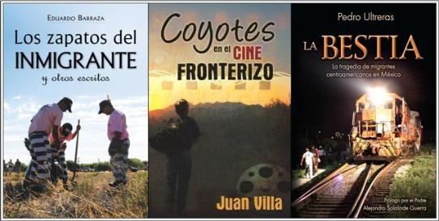
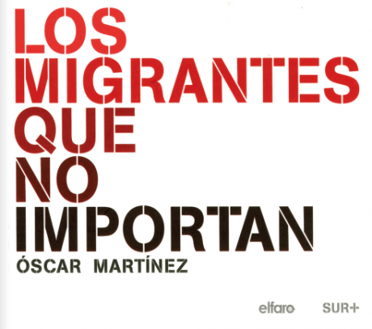
Other Works Used in Paper

Slide 16
What are the cultural aspects ingrained in this topic?
“El machismo”
Family values
Religion

Slide 17
What techniques do writers of this topic have a tendency to use & what are the stylistic commonalities and differences?
The writers that I choose to focus on use simple language to talk about complex issues
The basic vocabulary makes the books more comprehendible to a variety of audiences
Different authors focused on different aspects for example, Nazaro focused on what happens to the migrants after the journey as opposed to Martinez who focused more on the journey itself

Slide 18
Conclusion:
With more awareness of this topic, we can create social change

